Slide 1
Network Management Protocol
ANA JSK

Slide 2
Why
Instllation and configuration of network device Is one time activity
We do not require to install and configure the devices regularly
Maintaing and managing the network is the most critical job of network admin
Monitor the Functionality of devices , connection between network devices and keep services are up are the most critical task
Admin requires to check thousand of network devices and find the faults

Slide 3
Network management System
Network =data + control +Management
Set of applications to monitor network components
Component can be hardware or software
monitor or manage their entire business operations using a central computer.

Slide 4
Network management system :Use
Network device discovery
Network device monitoring
Network performance analysis
Network device management
Intelligent notifications, or customizable alerts

Slide 5
Quality nim features
Saves money
Saves time
Increase producivity

Slide 6
Simple Network Management Protocol
De facto standard for managing the network system
Most of the devices are bundled with SNMp agents which needs to be enabled and configured
Application layer protocol
UDP port 161 /162
RFC 121 1157 1155
SNMP offers a proactive approach ie it monitors all the events happing on devices such as router , host, switches , server , firewall etc ,recover those before it become a major problem which affect the functionalities of the network

Slide 7
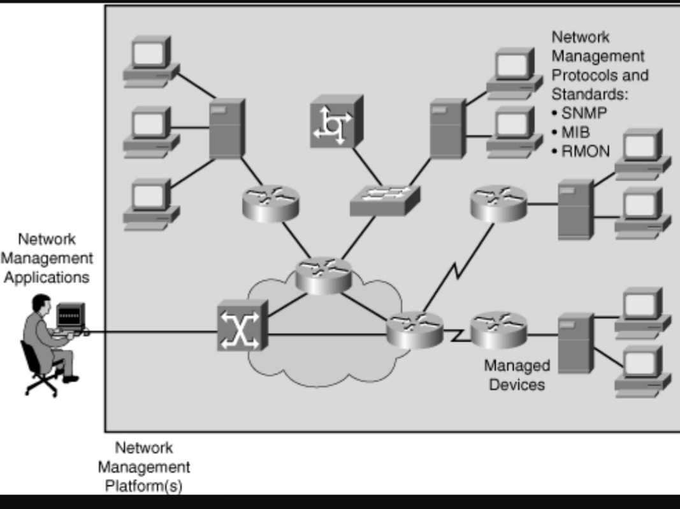
Network Management Architecture

Slide 8
Network Management Architecture
Network management system (NMS): A system that executes applications that monitor and control managed devices. NMSs provide the bulk of the processing and memory resources that are required for network management.
Network management protocol: A protocol that facilitates the exchange of management information between the NMS and managed devices, including SNMP, MIB, and RMON.
Managed devices: A device (such as a router) managed by an NMS.

Slide 9
Network Management Architecture
Managagent agents: Software, on managed devices, that collects and stores management information, including SNMP agents and RMON agents.
Management information: Data that is of interest to a device's management, usually stored in MIBs.
RMON agent is used to monitor devices remotely

Slide 10
MIB ....explored
Management Information Base and is a collection of information organized hierarchically.
MIB Example: The typical objects to monitor on a printer are the different cartridge states and maybe the number of printed files, and on a switch the typical objects of interest are the incoming and outgoing traffic as well as the rate of package loss or the number of packets addressed to a broadcast address.

Slide 11
OID
OIDs stands for Object Identifiers. OIDs uniquely identify managed objects in a MIB hierarchy. This can be depicted as a tree, the levels of which are assigned by different organizations. Top level MIB object IDs (OIDs) belong to different standard organizations.
Vendors define private branches including managed objects for their own products.

Slide 12
Structure of Management Information (SMI):
Data definition language for objects
ASN.
1 was defined by ISO and is used in SNMP.
2. Management Information Base (MIB):
Distributed network management data

Slide 13
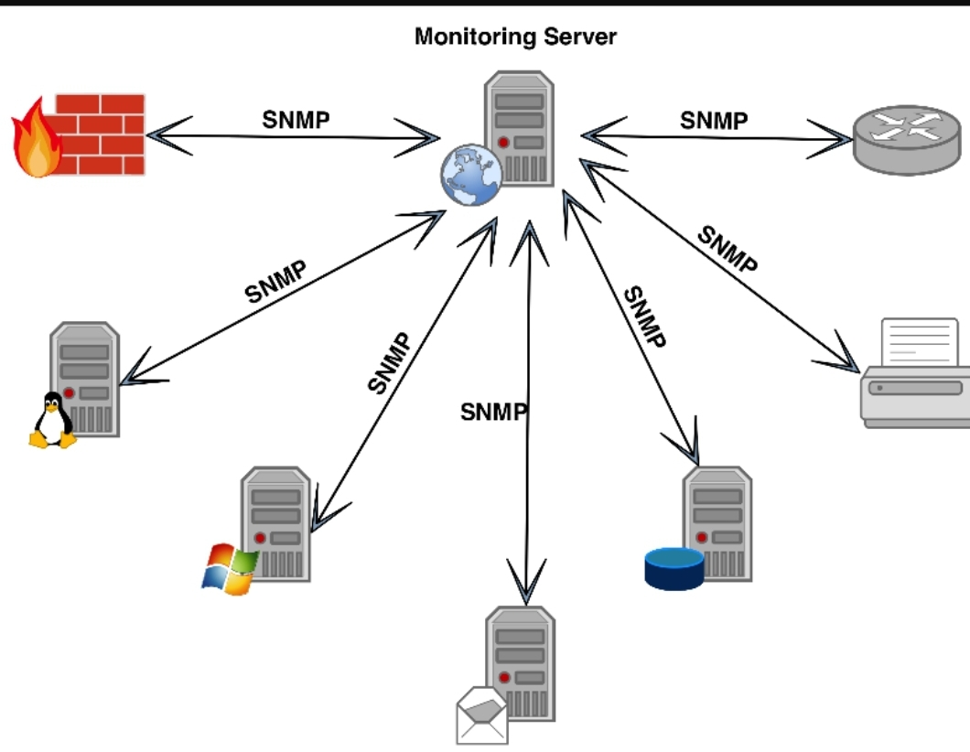

Slide 14
SNMP message
Get Request: Used by the manager to request a specific MIB variable from the agent.
Get Next Request: Used after the initial get request to retrieve the next object instance from a table or list.
Set Request: Used to set a MIB variable on an agent.
Get Response: Used by an agent to respond to a manager's Get Request or Get Next Request message.
Trap: Used by an agent to transmit an unsolicited alarm to the manager. A Trap message is sent when specific conditions occur, such as a change in the state of a device, a device or component failure, or an agent initialization or restart.

Slide 15
How Do SNMP Traps Work?
Imagine a scenario where a network management system (NMS) is responsible for monitoring a large number of devices, each with numerous objects.
Instead of the NMS polling or requesting information from every object on every device (which would be impractical), SNMP traps enable each agent to notify the manager without solicitation.
When an event occurs (e.g., a critical state change), the agent sends an unsolicited trap message to the NMS.
The NMS receives the trap, displays it, and can take action based on the event. For instance, it might directly poll the agent or query other associated device agents to gain a better understanding of the event.
Trap-directed notification helps save network and agent resources by eliminating unnecessary SNMP requests.
However, some SNMP polling is still necessary for discovery, topology changes, and situations where a managed device experiences a catastrophic outage.
SNMPv1 traps are defined by RFC 1157 and include fields such as the enterprise (identifying the type of managed object), agent address, generic trap type, specific trap code, time stamp, and variable bindings².
Why Are SNMP Traps Important?
SNMP traps play a vital role in network management by providing real-time notifications of critical events.
They allow administrators to proactively respond to issues, monitor device health, and ensure efficient network operation.
Whether it’s a sudden power failure or a security breach, SNMP traps keep the management station informed, enabling timely actions.
!

Slide 16
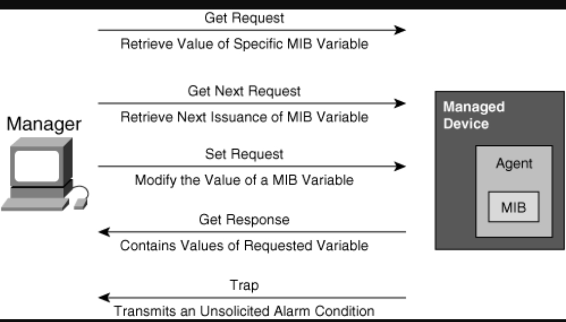

Slide 17
Security levels introduced in SNMPv3
NoAuthNoPriv: Without authentication and without privacy (encryption).
AuthNoPriv: With authentication but without privacy. Authentication is based on Hash-Based Message Authentication Code-Message Digest 5 or HMAC-Secure Hash Algorithm algorithms.
AuthPriv: With authentication as described earlier and privacy using the 56-bit Cipher-Block Chaining-Data Encryption Standard encryption standard.

Slide 18
What does Remote Monitoring (RMON) mean?
Remote Monitoring (RMON) is a standard specification that facilitates the monitoring of network operational activities through the use of remote devices known as monitors or probes. RMON assists network administrators (NA) with efficient network infrastructure control and management.

Slide 19
SNMP versions
SNMPv1 – It uses community strings for authentication and use UDP only.
SNMPv2c – It uses community strings for authentication. It uses UDP but can be configured to use TCP.
SNMPv3 – It uses Hash based MAC with MD5 or SHA for authentication and DES-56 for privacy.This version uses TCP. Therefore, conclusion is the higher the version of SNMP, more secure it will be.

Slide 20
Advantages and disadvantages of snmp
Advantages -Widely Accepted and works good for device monitoring -basic monitoring MIBs are ( like IF-MIB) are well defined and implemented in most of the devices -Vendor specific MIBs also defined , provides additional support -Very good for Fault management

Slide 21
Disadvantages - Wont scale, large retrieval are slower - Its complex to implement MIBs than CLI commands - Config rollback is not so easy - SNMP provide data centric view , difficult to relate to task centric view from operator point of view - MIBs lacks proper description , understanding will be difficult

Slide 22
Rose

Slide 25
Web reference and video
Web references
www.geekforgeeks.org
www.cisco.com
Video
https://youtu.be/PLjzgYyTQOs SNMP basics
https://youtu.be/5h0fN0j2XS8 SNMP and packet tracer

